Slide 1

Cross Selling Recommendation
Group Name: Solo Analyst
Name: Munirah Alfehaid
Email:munirah9hamad@gmail.com
Country: Saudi Arabia
Specialization: Data Analyst

Slide 2
Introduction
Client:
XYZ credit union in Latin America is performing very well in selling the Banking products (eg: Credit card, deposit account, retirement account, safe deposit box etc) but their existing customer is not not buying more than 1 product which means bank is not performing good in cross selling (Bank is not able to sell their other offerings to existing customer). XYZ Credit Union decided to approach ABC analytics to solve their problem.
Objective:
The EDA aims to understand customer behavior to help increase product sales to existing customers.

Slide 3

EDA Analysis

Slide 4
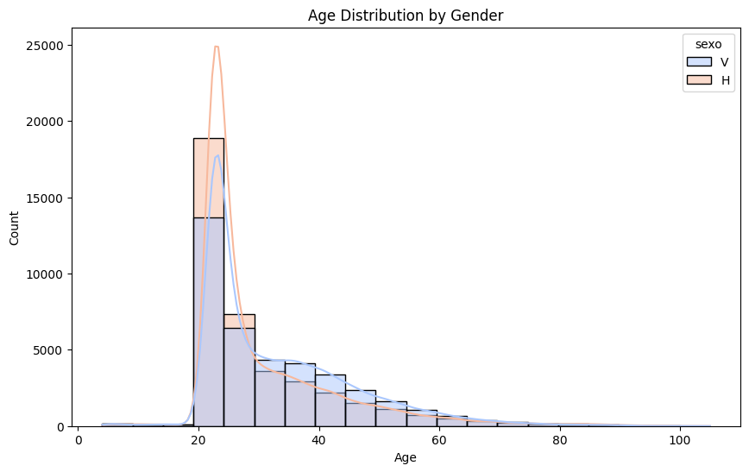
Customer Age and Gender
Most customers fall in the 20 to 40-year-old range, with a sharp peak around the 25-30 age group.
There are more male customers in this age range than females, as seen by the taller blue bars.
The chart shows that as age increases, the number of customers decreases for both genders.
There are outliers beyond 100 years of age, but they are very few.
This visualization suggests that the bank’s customer base is concentrated in the younger population (20-40), which could be important in understanding customer behavior and how to market different products for cross-selling.

Slide 5
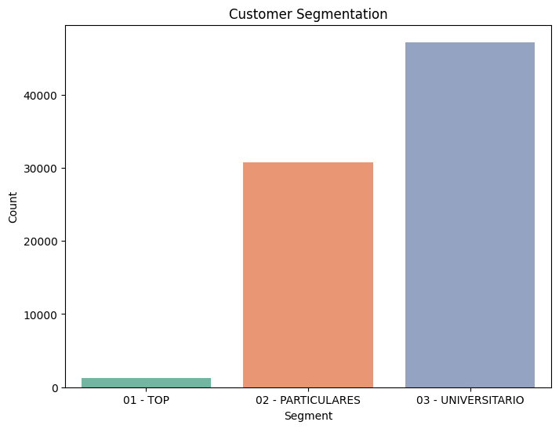
Customer Segmentation
PARTICULARES: The majority of the customers fall into this segment, indicating that regular banking services are the most commonly used among the bank's clients.
UNIVERSITARIO: This group is also substantial, suggesting the bank has a significant number of young or student customers.
TOP: This segment is quite small, meaning that there are relatively few high-value or priority customers.
This distribution is useful for tailoring marketing strategies and cross-selling products based on segment size and customer needs.

Slide 6
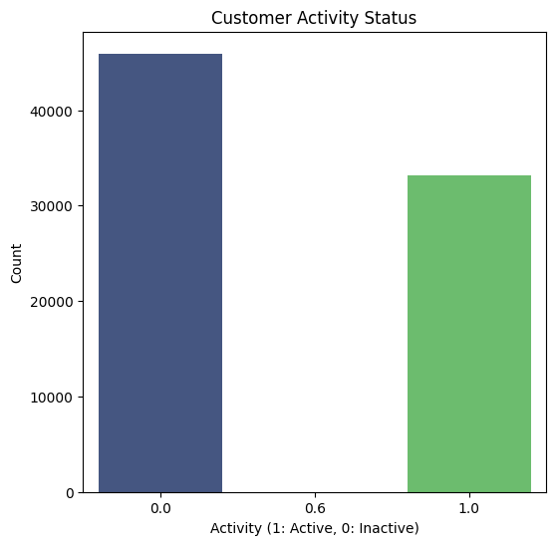
Customer Activity
Inactive Customers (0.0): There are more inactive customers than active ones, with over 500,000 customers in this category. This could suggest that a large portion of the bank’s customers are no longer using its products or services.
Active Customers (1.0): Although fewer in number compared to inactive customers, a substantial number (over 400,000) are still actively engaging with the bank.
This information could be valuable for designing re-engagement strategies aimed at converting inactive customers into active ones, such as offering promotions or customized products to encourage more interactions with the bank.

Slide 7
Recommendation
Target inactive customers to engage them.
Focus on segments like VIPs or individuals with high income who may be more likely to buy additional products.
Design specific campaigns for underrepresented segments.

Slide 8
Next Steps for Technical Users

Slide 9
Goal: Design a dashboard with the most important KPIs to track customer behavior, segment performance, and identify cross-selling opportunities.
Key Metrics to Capture:
1-Customer Count by Segment:
-Breakdown the number of customers in each segment (VIP, Individual/Particulares, University/Universitario).
2-Average Age by Segment:
-Show the distribution of customers' ages across different segments (VIP, Individual, University) using box plots or histograms.
3-Customer Activity Status (Active/Inactive):
-Distribution: Visualize the number of active versus inactive customers.
-Activity Rate by Segment: Break down activity status per customer segment (e.g., VIP has 70% active, Individual 50% active).
4Customer Product Ownership:
-Product Penetration: Show the distribution of customers who own various products (e.g., credit cards, loans, insurance).
-Product Bundling: Analyze which product combinations are most common (e.g., savings account + credit card).
-Cross-Selling Opportunities: Identify customers with high potential for cross-selling based on their current product portfolio and income levels.

